Slide 1

Effect of data pre-processing on
Machine learning performance
Melissa Gonsalves
Applied Machine Learning
Sem 2
M.E AI & DS

Slide 2
What is Data Proprocessing?
01
Real-world datasets often contain missing values, categorical variables, outliers, duplicated entries, and features measured on different scales. If such issues are not handled properly, machine learning algorithms may produce biased, unstable, or inaccurate predictions.
Data preprocessing is a fundamental step in the machine learning in which, inconsistent data is transformed into a clean and meaningful format suitable for model training.
It helps improve: Data quality, Predictive accuracy, generalization.

Slide 3
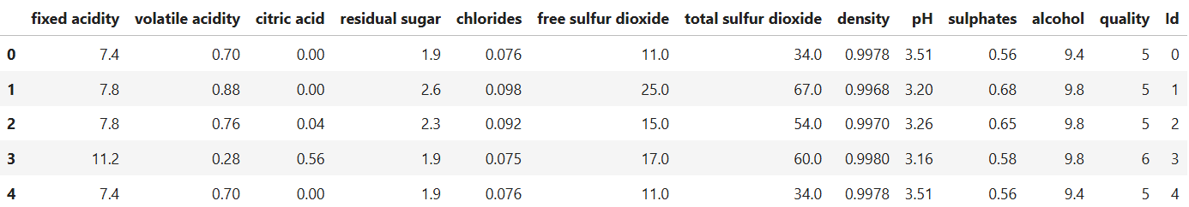
WINE QUALITY Dataset
02
Total Samples: 1143
The target variable is:
quality
It represents the quality score of wine samples.
Example classes:
3 (Poor Quality Wine)
4
5
6
7
8 (Best Wine Quality)

Slide 4
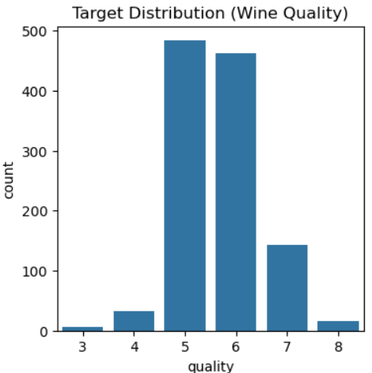
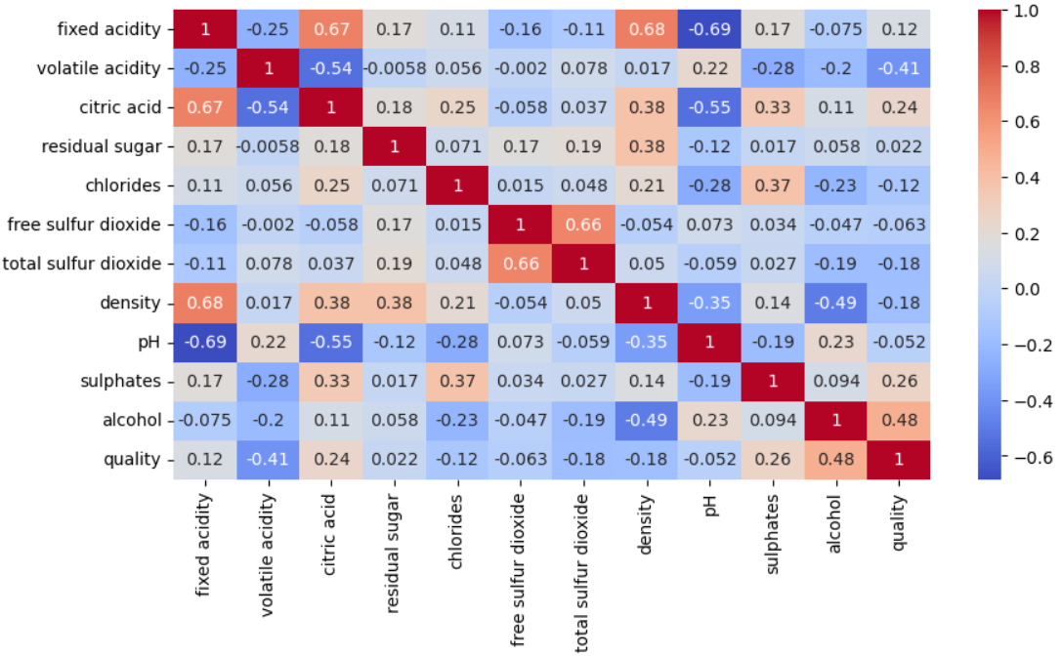
WINE QUALITY Dataset
03
#Distribution of class labels in the output classplt.figure(figsize=(4,4))
sns.countplot(x=df['quality’])
plt.title("Target Distribution (Wine Quality)")
plt.show()
#Correlation matrix of features
corr=df.corr()
plt.figure(figsize=(10,5))
sns.heatmap(corr, annoat=True, cmap='coolwarm')

Slide 5
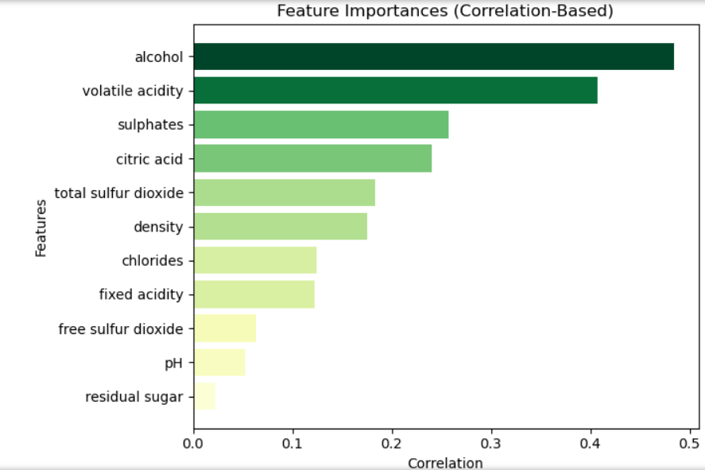
WINE QUALITY Dataset
04
#Feature Importance
correlations = df[numeric_cols.tolist() + ['quality']].corr()['quality'].drop('quality’)
importance = correlations.abs()
sorted_idx = np.argsort(importance.values)
sorted_features = importance.index[sorted_idx]
sorted_importances = importance.values[sorted_idx]
colors = plt.cm.YlGn(sorted_importances / max(sorted_importances))
plt.figure(figsize=(7,5))
plt.barh(sorted_features, sorted_importances, color=colors)
plt.xlabel("Correlation")
plt.ylabel("Features")
plt.title("Feature Importances (Correlation-Based)")
plt.tight_layout()plt.show()

Slide 6
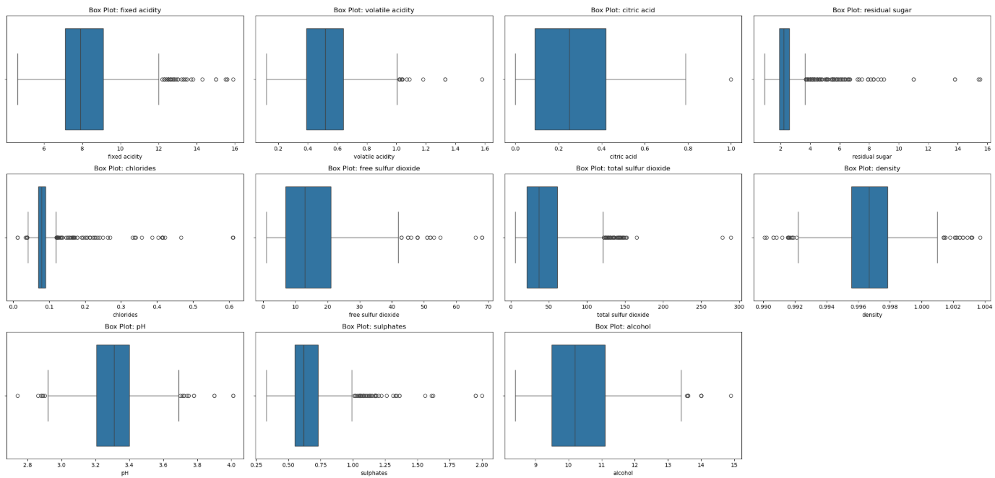
WINE QUALITY Dataset
05
# Box Plot to detect outliers
numeric_cols = df.select_dtypes(include='float64').columnsplt.figure(figsize=(25, 12))
for i, col in enumerate(numeric_cols, 1): plt.subplot(3, 4, i)
sns.boxplot(x=df[col])
plt.title(f"Box Plot: {col}")
plt.xlabel(col)
plt.tight_layout()
plt.show()
The extreme values seen
in the box plot are not outliers, but represent natural chemical variations in wine, removing this will worsen the class imbalance and model’s ability to generalize.

Slide 7
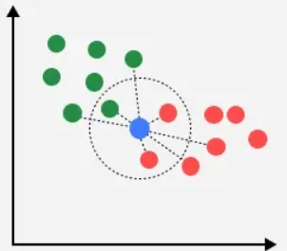

KNN (K-NEAREST NEIGHBOUR)
06
k-NN is a non-parametric supervised learning algorithm used for classification and regression.
The algorithm:
Stores training data.
Computes distance between test point and all training points.
Selects the nearest k neighbors.
Assigns the majority class.
Euclidean Distance
$$d\left(x , y\right)=\sqrt{\sum_{i=1}^{n}{(}\left.x_{i}−y_{i}{\left.)\right.}^{2}\right.}$$
Where:
$x_{i}$ and $y_{i}$ are feature values
$n$ is number of features
Why Preprocessing is Important for k-NN
k-NN is extremely sensitive to:
Feature scale
Missing values
Outliers
Irrelevant features
Because distance calculations are directly affected by feature magnitude.

Slide 8
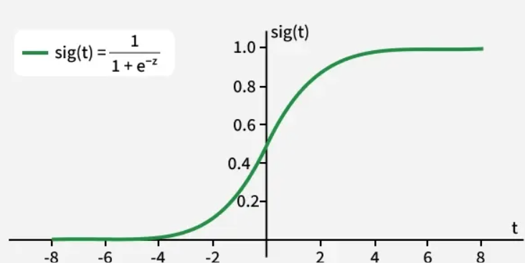

07
LOGISTIC REGRESSION
Logistic Regression is a probabilistic linear classification model.
It predicts probability using the sigmoid function:
$$P\left(y=1∣x\right)=\frac{1}{1+e^{−\left(w^{T}x+b\right)}}$$
Where:
$w$= weight vector
$x$= input feature vector
$b$= bias
Decision rule:
$$\hat{y}=\left\{\begin{matrix}1 & \text{if} P\left(y=1∣x\right)≥0.5 \\ 0 & \text{otherwise}\end{matrix}\right.$$
Why Preprocessing is Important
Logistic Regression depends on gradient-based optimization.
Large feature magnitudes:
Slow convergence
Cause unstable optimization
Produce biased coefficients
Importance of Standardization
Gradient descent converges faster when features are standardized.
Missing Values
Logistic regression cannot handle NaN values directly.
Encoding
Categorical variables must be transformed numerically.

Slide 9
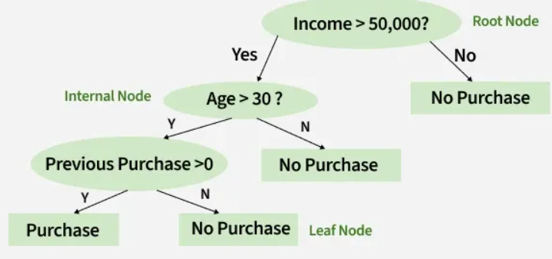

08
DECISION TREE
Decision Trees split data recursively using impurity measures.
Common criteria:
Gini Index
Entropy
Information Gain
Entropy Formula
$$Entropy\left(S\right)=−\sum_{i=1}^{n}{p_{i}}log2\left(p_{i}\right)$$
Information Gain
$$IG=Entropy\left(parent\right)−WeightedEntropy\left(children\right)$$
Why Preprocessing is Less Important
Decision Trees are:
Scale invariant
Non-distance based
Normalization often provides little improvement
Standardization usually unnecessary
Missing values still affect splitting
Poor encoding can affect categorical interpretation

Slide 10
PRE-PROCESSING TECHNIQUES

Slide 11

09
HANDLING MISSING VALUES
Mean Imputation
Concept
Missing numerical values are replaced with the mean of observed values.
Formula
$$\overset{ˉ}{x}=\frac{1}{n}\sum_{i=1}^{n}{x_{i}}$$
Missing value replacement:
$$x_{missing}=\overset{ˉ}{x}$$
Advantages
Simple
Fast
Preserves dataset size
Disadvantages
Reduces variance
Distorts correlations
Sensitive to outliers

Slide 12
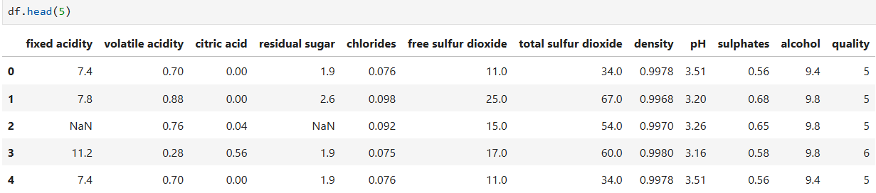
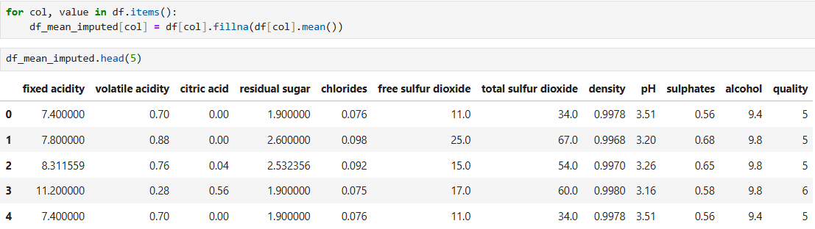






10
HANDLING MISSING VALUES
Mean Imputation

Slide 13
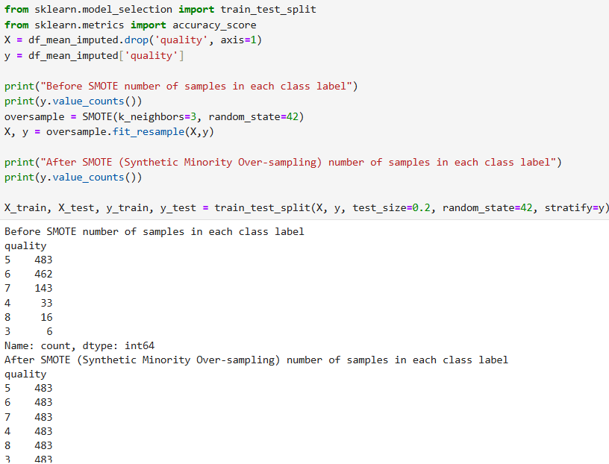
11
HANDLING MISSING VALUES
Mean Imputation

Slide 14
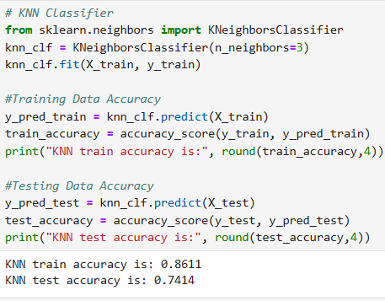
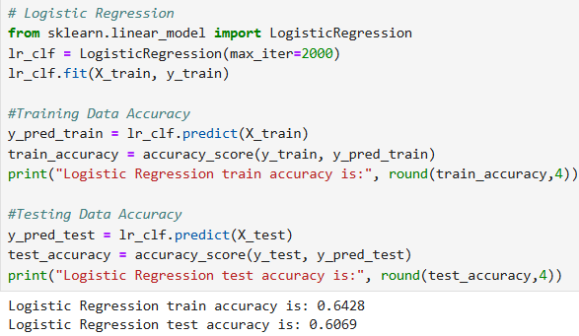
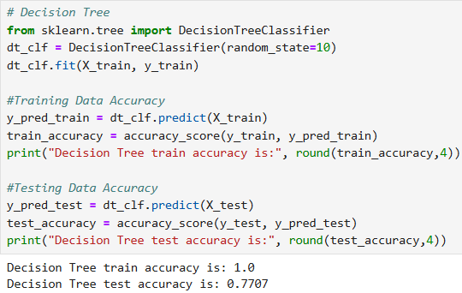
12
HANDLING MISSING VALUES
Mean Imputation

Slide 15

13
HANDLING MISSING VALUES
2. KNN Model based Imputation
Missing values are estimated using nearest neighbouring samples.
Procedure
Find k nearest samples
Compute average of neighbors
Replace missing value
Formula
$$x_{missing}=\frac{1}{k}\sum_{i=1}^{k}{x_{i}}$$
Advantages
Preserves local structure
More accurate than mean imputation
Disadvantages
Computationally expensive
Sensitive to scaling

Slide 16
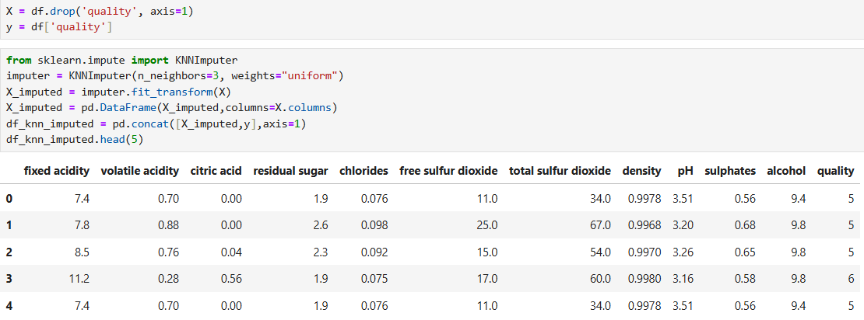







14
HANDLING MISSING VALUES
2. KNN Model based Imputation

Slide 17
15
DATA ENCODING FOR PREPROCESSING
Label Encoding
Machine-learning algorithms cannot directly process text labels, so categorical values must be converted to numbers.
Label encoding is appropriate when:
The categories have no order (nominal data)
The column has only unique values.
fixed acidity | citric acid | alcohol | type
7.4 | 0.00 | 9.4 | red
7.8 | 0.04 | 10.0 | white
After Label encoding:
fixed acidity | citric acid | alcohol | type
7.4 | 0.00 | 9.4 | 0
7.8 | 0.04 | 10.0 | 1

Slide 18
16
DATA ENCODING FOR PREPROCESSING
2. Ordinal Encoding
Ordinal Encoding translates text or labels into unique integers based on an inherent, meaningful order or rank.
fixed acidity | alcohol | quality_label
7.4 | 9.4 | low
7.8 | 10.5 | medium
7.3 | 9.9 | low
6.9 | 11.0 | high
After Ordinal Encoding:
fixed acidity | alcohol | quality_label
7.4 | 9.4 | 0
7.8 | 10.5 | 1
7.3 | 9.9 | 0
6.9 | 11.0 | 2

Slide 19

17
STANDARDIZATION METHODS FOR DATA PREPROCESSING
Z-Score Standardization
A z-score gives you an idea of how far from the mean a data point is. More technically, it’s a measure of how many standard deviation below or above the population mean a raw score is.
Formula:
z = (x – μ) / σ
Where:
$μ$= mean
$σ$= standard deviation
Properties
Mean becomes 0
Standard deviation becomes 1
Importance
Prevents dominance of large-scale features.
Model Impact
k-NN: Strong improvement due to balanced distances.
Logistic Regression: Improves optimization convergence.
Decision Tree: Minimal effect.

Slide 20
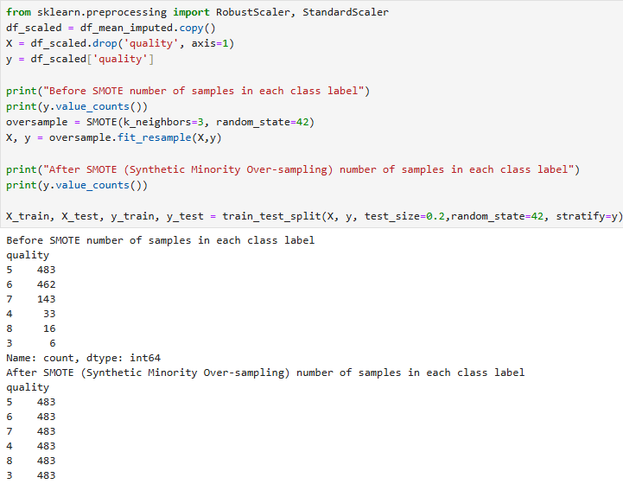
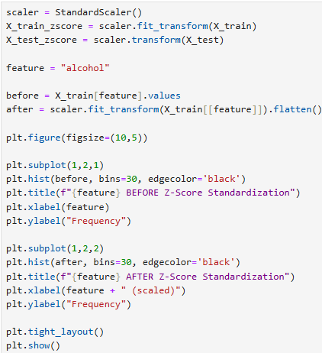
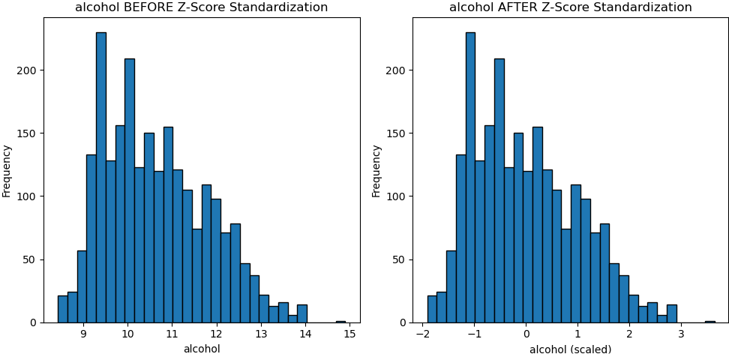



STANDARDIZATION METHODS FOR DATA PREPROCESSING
18
Z-Score Standardization

Slide 21

19
STANDARDIZATION METHODS FOR DATA PREPROCESSING
2. Robust Scaler Standardization
Is used to scale features so that they are centered around 0 and have uniform spread. It uses median and IQR , making it highly resilient to extreme outliers.
Formula
$$x^{′}=\frac{x−Median}{IQR}$$
Where:
$$IQR=Q_{3}−Q_{1}$$
Importance
Robust against outliers.
Model Impact
k-NN: Useful when dataset contains extreme values.
Logistic Regression: Improves stability under skewed distributions.
Decision Tree: Minor improvement only.

Slide 22
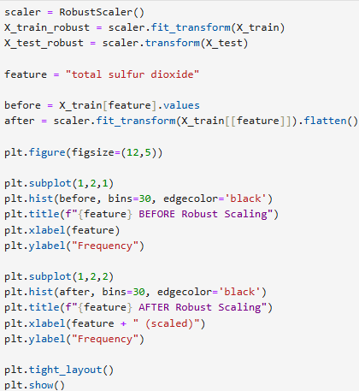
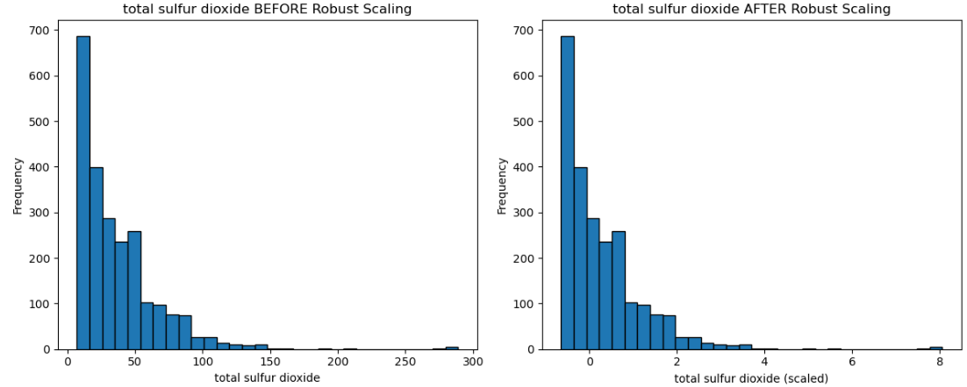



20
STANDARDIZATION METHODS FOR DATA PREPROCESSING
2. Robust Scaler Standardization

Slide 23

21
NORMALIZATION METHODS FOR DATA PREPROCESSING
Min-Max Normalization
Normalization rescales data into bounded ranges.
Formula
$$x^{′}=\frac{x−x_{min}}{x_{max}−x_{min}}$$
Output Range
$$0≤x^{′}≤1$$
Model Impact
k-NN
Highly beneficial because distances become balanced.
Logistic Regression
Improves gradient descent performance.
Decision Tree
Usually unnecessary.

Slide 24
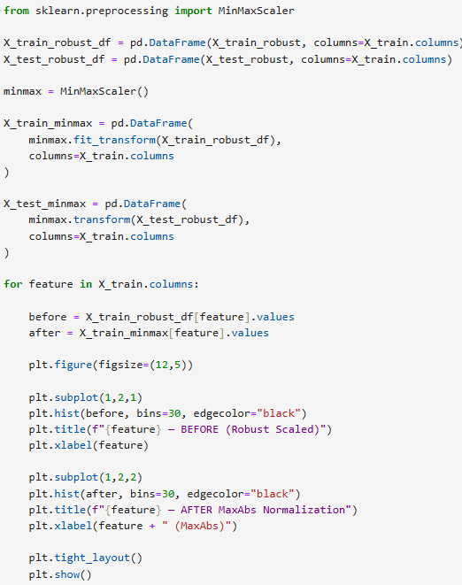
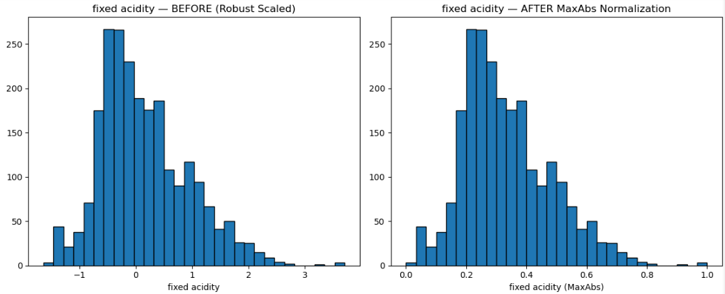



22
NORMALIZATION METHODS FOR DATA PREPROCESSING
Min-Max Normalization

Slide 25

23
NORMALIZATION METHODS FOR DATA PREPROCESSING
2. Log Normalization
Formula
$$x^{′}=log⁡\left(x+1\right)$$
Purpose
Reduces skewness.
Advantages
Compresses large values
Stabilizes variance
Disadvantages
Cannot directly process negative values.
Model Impact
Logistic Regression
Improves linear separability.
k-NN
Improves neighborhood structure for skewed data.
Decision Tree
Sometimes improves split quality.

Slide 26
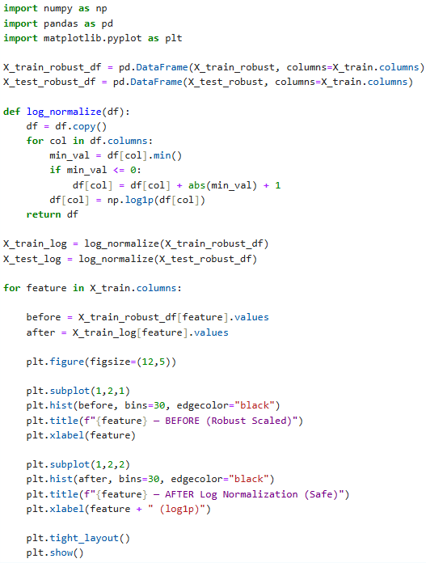
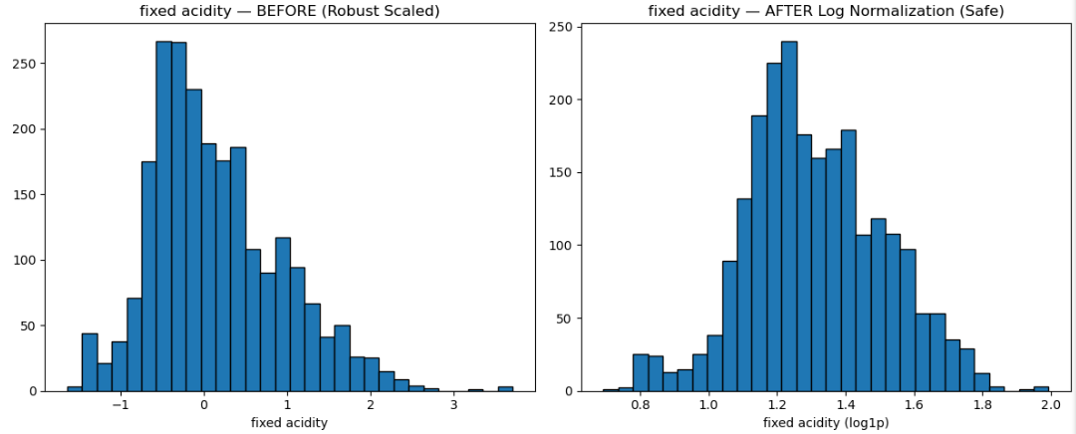



NORMALIZATION METHODS FOR DATA PREPROCESSING
24
2. Log Normalization

Slide 27

25
NORMALIZATION METHODS FOR DATA PREPROCESSING
3. Max Absolute Normalization (MaxAbs Normalization)
Formula
$$x^{′}=\frac{x}{∣x_{max}∣}$$
Output Range
$$−1≤x^{′}≤1$$
Advantages
Preserves sparsity
Useful for sparse datasets
Model Impact
Logistic Regression
Efficient for sparse inputs.
k-NN
Moderate improvement.
Decision Tree
Minimal impact.

Slide 28
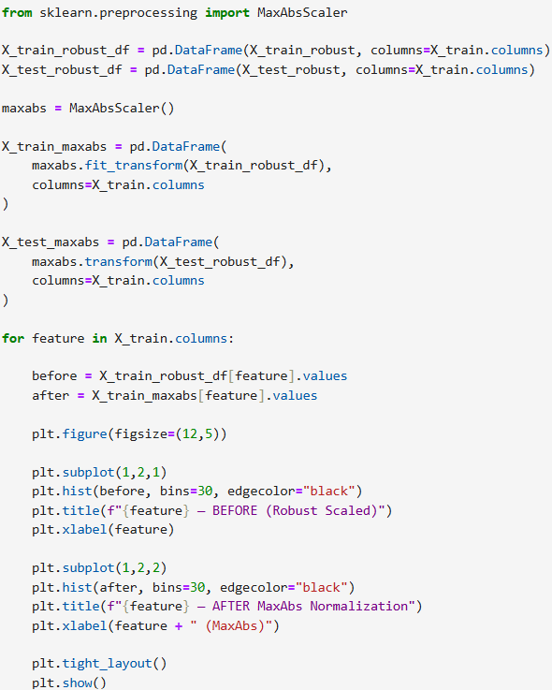
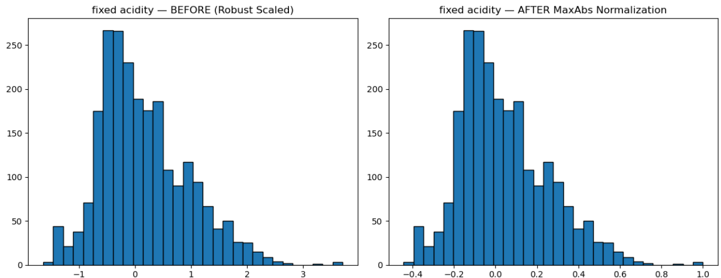



NORMALIZATION METHODS FOR DATA PREPROCESSING
26
3. Max Absolute Normalization (MaxAbs Normalization)

Slide 29
IMPLEMENTATION

Slide 30
27
SUMMARY
 | KNN | LOGISTIC REGRESSION | DECISION TREE
1. Before Data Preprocressing | KNN train accuracy is: 0.8654 KNN test accuracy is: 0.7431 | Logistic Regression train accuracy is: 0.6225 Logistic Regression test accuracy is: 0.5966 | Decision Tree train accuracy is: 1.0 Decision Tree test accuracy is: 0.7793
2. Mean Imputation | KNN train accuracy is: 0.8611 KNN test accuracy is: 0.7414 | Logistic Regression train accuracy is: 0.6428 Logistic Regression test accuracy is: 0.6069 | Decision Tree train accuracy is: 1.0 Decision Tree test accuracy is: 0.7707
3. Robust Scaler Standardization | KNN train accuracy is: 0.8973 KNN test accuracy is: 0.8 | Logistic Regression train accuracy is: 0.6475 Logistic Regression test accuracy is: 0.6552 | Decision Tree train accuracy is: 1.0 Decision Tree test accuracy is: 0.769
4. MaxAbs Normalization | KNN train accuracy is: 0.8934 KNN test accuracy is: 0.7879 | Logistic Regression train accuracy is: 0.6264 Logistic Regression test accuracy is: 0.6069 | Decision Tree train accuracy is: 1.0 Decision Tree test accuracy is: 0.7707

Slide 31
28
SUMMARY INTERPRETATION
KNN is a distance-based algorithm. It classifies samples using nearest neighbors based on distance calculations. Hence scaling the data values improves its performance.
However its performance improves on balancing the datset. Logistic Regression assumes mostly linear relationships. Wine quality data is highly nonlinear. Logistic Regression struggles to model such nonlinear class boundaries.
Decision Trees do NOT depend on distance calculations. They split based on thresholds not Euclidean distance. Therefore RobustScaler and MaxAbsScaler had minimal effect on its performance.

Slide 32
Thank You!

